Slide 1

BREAST CANCER PREDICTION
Saturday, October 29, 2022

Slide 2




TEAM KERAS
Other Active Members
Etieneabasi Kingsley Effiong | Triumph Urias | Esther Opeyemi Ogundoyin
Lilian Chidinma Nwafor | Princess Amadi | Abdus-Salaam AbdulHafiz
Esther Chizitere Amadi | Obinna Nwachukwu | Sakeenat Adesina
Adesokan Sulaimon Adewale | Akinlabi Akinkunmi Taofeek | Adetola Adebanwo
Orina Tolulope | Adesina Lekan Samuel | Joy Abiodun
Ayisha Parveen
Akinrotimi Feyisola
Role: Presenter 1
Role: Presenter 2
Project Lead
Egunjobi Tunde
Assistant Project Lead
Abdulakeem Yusuf Ademola
Query Analyst
Richard Orimolade

Slide 3
PROBLEM STATEMENT
The most prevalent form of cancer in women, breast cancer accounts for 20% of all tumors in women. This second-leading cause of cancer death in both men and women has been linked to multiple fatalities, which is cause for concern. As a result, the goal of this project is to:
Determine when cancer has the potential to cause harm, including death.
Train a machine learning model that predicts the benignity or malignancy of a cancer based on the dataset provided.

Slide 4
EXISTING SOLUTIONS
DeepLesion, a deep learning algorithm developed by the Massachusetts General Hospital (MGH) and Harvard Medical School (HMS) research team in 2017 which uses large scale clinical lesion annotations from the American College of Radiology Imaging Network (ACRIN) to detect lesions and cancer.
Creation of a novel risk prediction model for breast cancer by Palmer and colleagues which analyzed epidemiologic data from three case-control studies of Black women from different parts of the U.S.

Slide 5
OUR APPROACH
This project explored various perceptions, such as:
Reversal of the 'Diagnosis' column to correct the mislabeling of the malignant and benign tumors.
Thereafter, a viable machine learning model was created.

Slide 6
DATASET DESCRIPTION
The dataset was obtained from Dr. William H. Wolberg at the University of Wisconsin Hospitals in Madison via Kaggle. (https://www.kaggle.com/datasets/merishnasuwal/breast-cancer-prediction-dataset).
It was created for "AI for Social Good: Women Coders' Bootcamp" organized by Artificial Intelligence for Development in collaboration with UNDP Nepal.
It includes a variety of breast cancer instances to aid in identifying breast cancer in females.

Slide 7
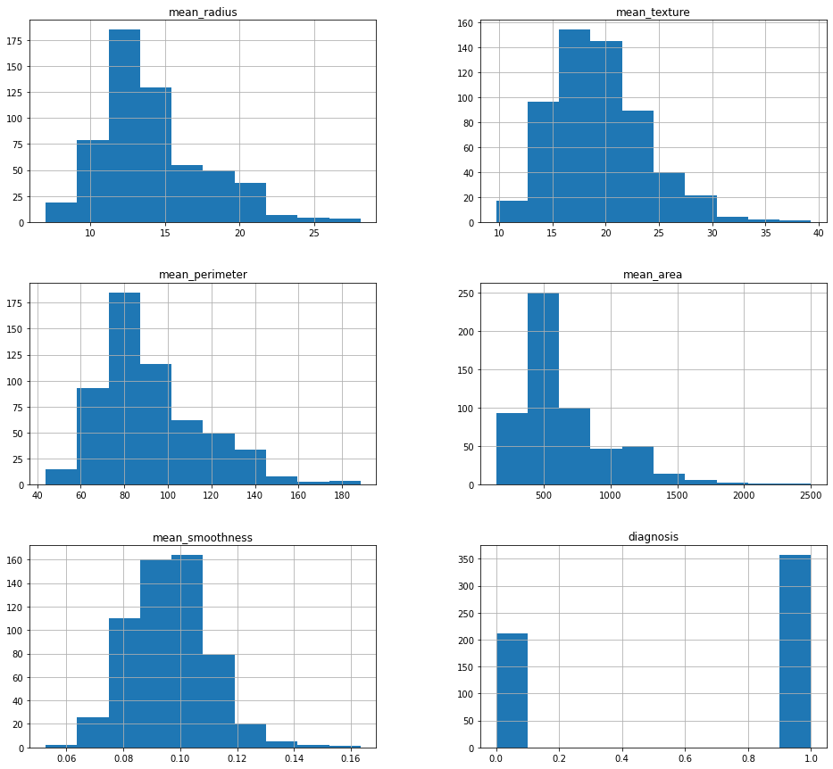
EXPLORATORY DATA ANALYSIS
This illustrates the various distribution plot of the different features in the dataset.
It shows the lowest and highest value of each feature.
It also shows the frequency of the values.

Slide 8
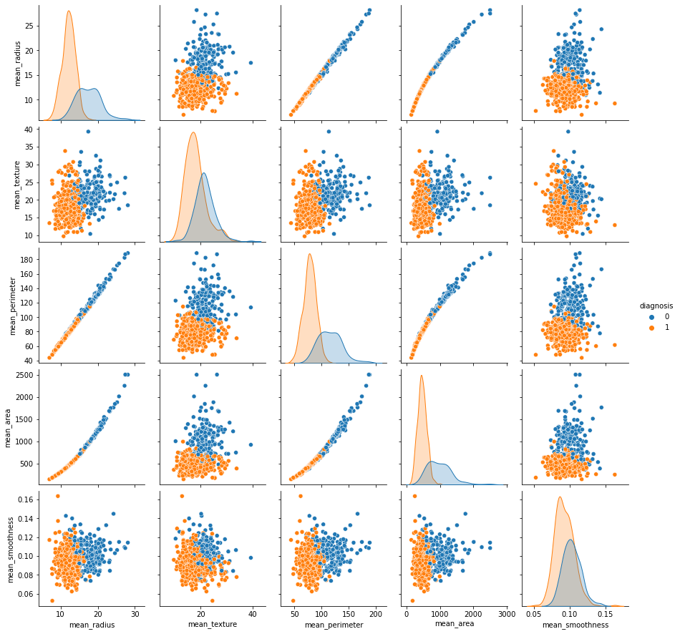
VISUALIZATION

Slide 9
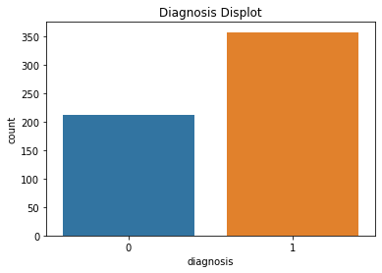
VISUALIZATION

Slide 10
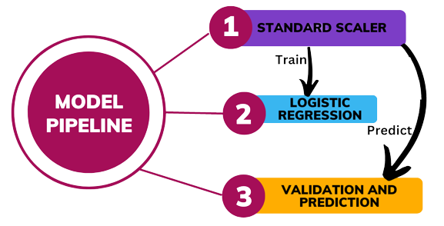
MODEL

Slide 11
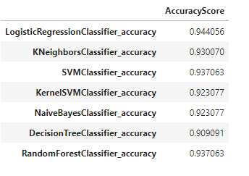
MODEL
Prior to removing false negatives, 'Logistic Regression' and 'Kernel SVM' provide the highest accuracy score, but this cannot be the only parameter used to determine the best model.

Slide 12
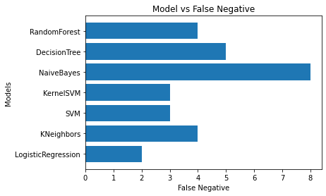
MODEL
Model evaluation after dropping of false negatives

Slide 13
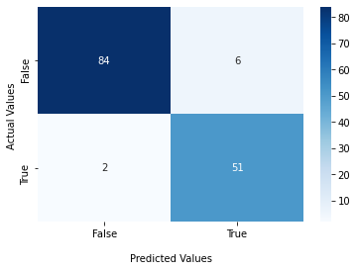
model
For validation, Logistic Regression recorded the least number of false negative. Therefore, Logistic regression remains our best bet for predicting cancer.
Classification for Logistic Regression:-------------------
precision recall f1-score support
0 0.98 0.93 0.95 90
1 0.89 0.96 0.93 53
accuracy 0.94 143
macro avg 0.94 0.95 0.94 143
weighted avg 0.95 0.94 0.94 143
----------------------------------------------------------

Slide 14
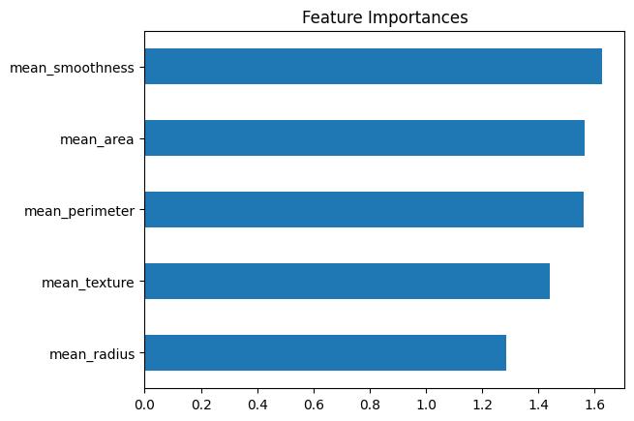
FEATURE IMPORTANCE

Slide 15
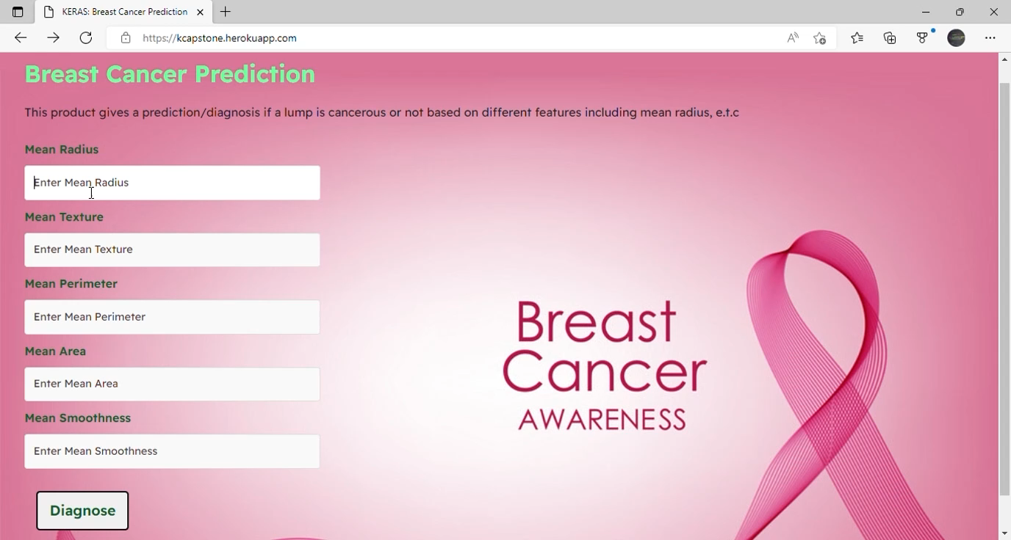
MODEL DEMO
The deployed model can be viewed on this link

Slide 16
SUMMARY AND CHALLENGES
At the conclusion of the project, we were able to develop a model that accurately predicts the malignancy or benignity of cancer, even though the dataset provided was insufficient to examine multiple pathways.

Slide 17
PROJECT LINKS
The following links provide access to additional details on project, related codes and article, as well as the prediction engine:
https://kcapstone.herokuapp.com/
https://github.com/Keras-Capstone
Canva
Breast Cancer Prediction Article by Team Keras

